Slide 1


AMBA APB – Case Study
Testing & Verification
Dept. of Computer Science & Engg, IIT Kharagpur
Pallab Dasgupta
Professor, Dept. of Computer Science & Engg.,
Professor-in-charge, AVLSI Design Lab,
Indian Institute of Technology Kharagpur

Slide 2
Advanced Microcontroller Bus Architecture (AMBA)
Defines an on-chip communications standard for designing high-performance embedded microcontrollers
Three Components:
  Advanced High-performance Bus (AHB)
  Advanced System Bus (ASB)
  Advanced Peripheral Bus (APB)
High-bandwidth
On-chip RAM
High-performance
ARM processor
B
R
I
D
G
E
UART
Timer
High-bandwidth
Memory Interface
AHB or ASB
APB
Keypad
PIO
DMA bus
master
APB bridge

Slide 3
APB & Its State Diagram
APB is used to interface to any peripherals which are of low bandwidth and do not require high performance of pipelined bus interface
Salient Features:
  Low power consumption
  Reduced interface complexity
  Latched address & control
  Suitable for many peripherals
No Transfer
IDLE
PSELx = 0
PENABLE = 0
Transfer
SETUP
PSELx = 1
PENABLE = 0
ENABLE
PSELx = 1
PENABLE = 1
No Transfer
Transfer
APB State Diagram

Slide 4
APB Bridge Interface
APB bridge is the only bus master on the AMBA APB.
APB bridge is also a slave on the higher-level system bus.
PSEL1
PSEL2
.
System bus
Slave interface
.
Selects
.
PSELn
APB
Bridge
PENABLE
Strobe
Read data
PRDATA
PADDR
Address
and
Control
PRESETn
PWRITE
Reset
Clock
PCLK
PWDATA
Write data

Slide 5
APB Slave Interface
APB slaves have a simple, yet flexible, interface.
Exact implementation of the interface will be dependent on the design style employed and many different options are possible.
Select
PSELx
Strobe
PENABLE
Address
and
Control
PADDR
PWRITE
APB
Slave
Reset
PRESETn
Clock
PCLK
Write data
PWDATA
PRDATA
Read data

Slide 6
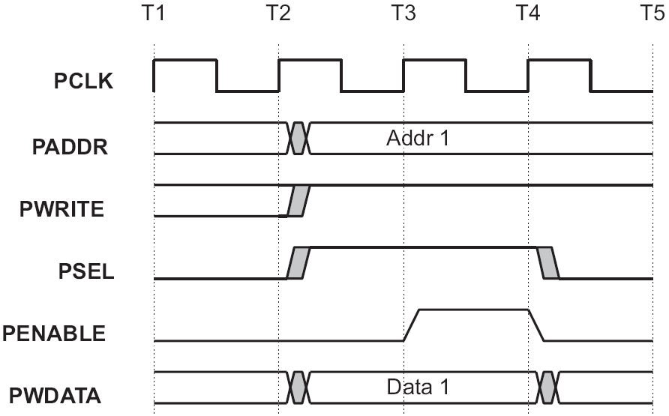
APB Write Transfer

Slide 7
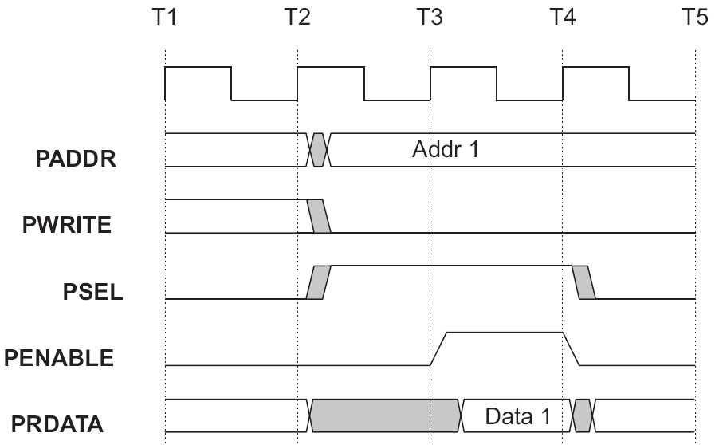
APB Read Transfer
PCLK

Slide 8
Layered Random Test Architecture
creates
interesting
conditions
creates
random
transactions
Test Bench
Tests
checks
correctness
identifies
transactions
Generators
Verification
Environment
executes
transactions
Transactor
Self-Check
Checker
supplies data
to the DUT
Driver
Assertions
Monitor
DUT
observes data
from the DUT

Slide 9
Environment Setup & Execute
Top-level test bench instantiates the DUT environment, builds it and runs all steps in layered architecture by executing this environment
The test environment structure is as follows:
  dut_env env; // DUT Environment
  initial begin
  env = new(mst_if, mon_if);
  // Creating environment: Master Interface and Monitor Interface
  env.build(); // Building environment
  env.run(); // Run all steps
  end

Slide 10
Components of Environment
Test bench Top-level components include:
  APB Atomic Generator
  APB Master
  APB Monitor
  Scoreboard
  apb_cfg cfg; // specifies transaction
  // configuration
  apb_trans_channel gen2mas; // channel between
  // generator & master
  apb_trans_channel mon2scb; // channel between
  // monitor & score-board
  apb_trans_atomic_gen gen; // APB transaction generator
  apb_master mst; // APB master
  apb_monitor mon; // APB monitor
  dut_sb scb; // scoreboard

Slide 11
Overall Execution Flow
Generate Configuration
for Tests
class apb_cfg;
rand int trans_cnt;
Generate Random
Test Scenarios
this.randomized_obj.randomize();
$cast(tr,this.randomized_obj.copy());
this.out_chan.put(tr);
Execute Individual Test
Scenarios
in_chan.get(tr);
if ((tr.dir) == apb_trans::WRITE) do_write(tr);
Execute Commands
Corresponding to Test
task apb_master::do_write(apb_trans tr);
…
endtask: do_write

Slide 12
Signal Layer
Specifies DUT interface signals
  interface apb_if(input PClk);
  logic [`APB_ADDR_WIDTH-1:0] PAddr;
  logic PSel;
  logic [`APB_DATA_WIDTH-1:0] PWData;
  logic [`APB_DATA_WIDTH-1:0] PRData;
  logic PEnable;
  logic PWrite;
  logic Rst;
  /* master & monitor clocking blocks */
  modport Master(clocking master_cb);
  modport Monitor(clocking monitor_cb);
  modport Slave(input PAddr, PClk, PSel, PWData,
  PEnable, PWrite, Rst, output PRData);
  endinterface

Slide 13
Command Layer
APB master implements driver routines named do_read(), do_write() and do_idle()
  task apb_master::do_write(apb_trans tr);
  // Drive Control bus
  `APB_MASTER_IF.PAddr <= tr.addr;
  `APB_MASTER_IF.PWData <= tr.data;
  `APB_MASTER_IF.PWrite <= 1'b1;
  `APB_MASTER_IF.PSel <= 1'b1;
  // Assert Penable
  ##1 `APB_MASTER_IF.PEnable <= 1'b1;
  // Deassert it
  ##1 `APB_MASTER_IF.PEnable <= 1'b0;
  endtask: do_write

Slide 14
Functional Layer
Functional layer (APB master) receives the transaction generated by the scenario layer from the channel.
apb_trans tr;
  in_chan.get(tr);
  case (tr.dir)
  apb_trans::READ: do_read(tr);
  apb_trans::WRITE: do_write(tr);
  default: do_idle();
  endcase

Slide 15
Scenario Layer
Scenario layer (APB atomic generator) creates individual transaction object & sends to the functional layer through channel
apb_trans tr;
apb_trans_atomic_gen::new(…);
this.addr = 0; this.data = 0; this.dir=IDLE;
endfunction:new
apb_trans_atomic_gen::main(…);
this.randomized_obj.randomize();
$cast(tr, this.randomized_obj.copy()); this.out_chan.put(tr);
endfunction:main

Slide 16
Test Layer
env creates an object of apb_cfg which contains the configuration for the tests for APB VIP
  class apb_cfg;
    rand int trans_cnt;
    constraint basic {
    trans_cnt > 5;
    trans_cnt < 10;
    }
  endclass: apb_cfg
  apb_cfg cfg;
  cfg.randomize();

Slide 17
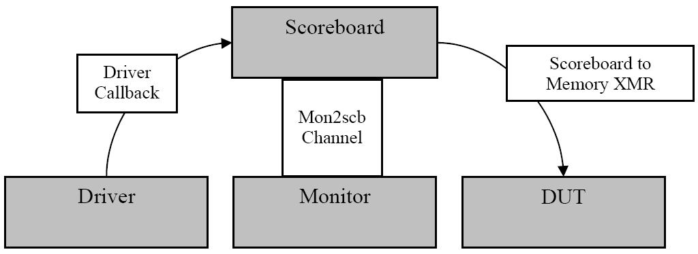
Monitor Execution Flow

Slide 18
Functional Layer (Monitor)
dut_env creates an object of dut_sb which implements the checker component
Implements check_read, check_write etc.
scoreboard waits for a transaction to be generated then waits for the monitor to notify that this transaction occurred.
determines the transaction correctness by applying the following:
  Each generated WRITE transactions are stored to a register file (which acts as a reference model in this case).
  Each generated READ transactions get their data field filled from the register file (so to provide an expected result).
  each transactions is then compared on a first-come first-serve basis.

Slide 19
Functional Layer (code snippet for checker)
Executes the following code in infinite loop:
mon2scb.get(mon_tr);
mas_tr = from_master_q.pop_front();
exp_data = top.m1.memory_read(mas_tr.addr);
case(mas_tr.dir)
apb_trans::WRITE: check_write(mas_tr, mon_tr, exp_data);
apb_trans::READ: check_read (mas_tr, mon_tr, exp_data);
default: `vmm_fatal(log, "Fatal error: Scoreboard received illegal master transaction");
endcase
if(match >= max_trans_cnt) begin
`vmm_verbose(this.log, $psprintf("Done scorboarding found %d matches", match));
this.notify.indicate(this.DONE);
end

Slide 20
Command Layer (Checker)
APB-Monitor uses callbacks to monitor the bus before and after the transaction
while(1) begin
$cast(tr, randomized_obj.copy());
// Pre-Rx Callback
`vmm_callback(apb_monitor_callbacks ,monitor_pre_rx(this, tr));
// Sample the bus using the apb_sample() task
sample_apb(tr);
// Put the trans into the output channel
out_chan.put(tr);
// Add a Post-Rx Callback. Typically for Coverage or Scoreboard
`vmm_callback(apb_monitor_callbacks ,monitor_post_rx(this, tr));
`vmm_debug(log, tr.psdisplay("Monitor ==>"));
end

Slide 21
AMBA APB Property Set
PSEL:
  If PSELx is LOW for some slave x in the present cycle (1ST) and in the next (2nd) cycle it goes HIGH, it must be also HIGH in the next (3rd) cycle.
  At a time only one PSEL can be high i.e. only 1 slave can be selected at a time.
PENABLE:
  If PENABLE is HIGH in the present cycle, it must go LOW in the next cycle.

Slide 22
AMBA APB Property Set (contd..)
PSEL & PENABLE:
  If PSELx is LOW for some slave x in the present cycle (1st) and in the next cycle (2nd) it becomes HIGH then one more cycle later (3rd) PENABLE must also be HIGH.
  If all of the PSEL is LOW in the present cycle (1st) then in the same cycle (1st) & also in the next cycle (2nd) PENABLE must also be LOW.
  If PENABLE is HIGH (1st) and in the next cycle (2nd) PSEL is HIGH, then one more cycle (3rd) later PSEL & PENABLE are both HIGH.

Slide 23
AMBA APB Property Set (contd..)
PENABLE & PWDATA:
  If PENABLE is HIGH in the present cycle then PWDATA will hold the same value as the previous cycle.
PSEL & PWRITE:
  If PWRITE changes one of the PSEL must be HIGH.
PENABLE & PWRITE:
  If PENABLE is HIGH in the present cycle then PWRITE will hold the same value as the previous cycle.
PENABLE & PADDR:
  If PENABLE is HIGH in the present cycle then PADDR will hold the same value as the previous cycle.

